Slide 1
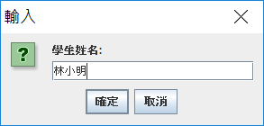
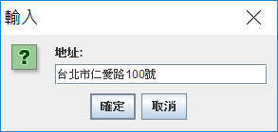
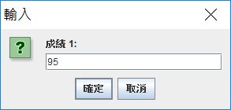
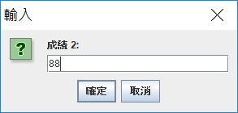



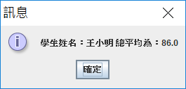
In-class Assignment #6 (A/B班)
Student class has variables: name(String), address(String), and grades which is an integer array to store a student’s five exam scores. Besides, class Student has a functional method: printAvg() that calculates and returns the average scores. In another class: Registration, you create a student object by using input dialogs for entering the data of the variables, then use a message dialog to show the student name and the average score.
Implement Student.java and Registration.java according to the above description. Use a for loop for showing the input dialogs for the exam scores and entering the grade data to the array.

